Slide 1
Fully Convolutional Networks
Pattern Recognition & Machine Learning Laboratory
Sangho Kim
Aug 10, 2021

Slide 2
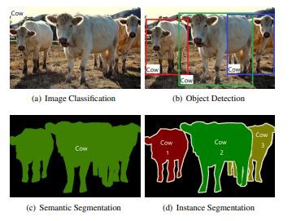
Introduction
Classification
Determine which objects are in the image and assign class labels
AlexNet, VGGNet, GoogleNet
Detection
Determine what objects are in the image and specify where they are in the image
R-CNN, Fast R-CNN, Faster R-CNN
Segmentation
Separate meaningful objects in pixels from the image
Fully Convolutional Networks (FCN)
Comparison of different visual recognition tasks

Slide 3
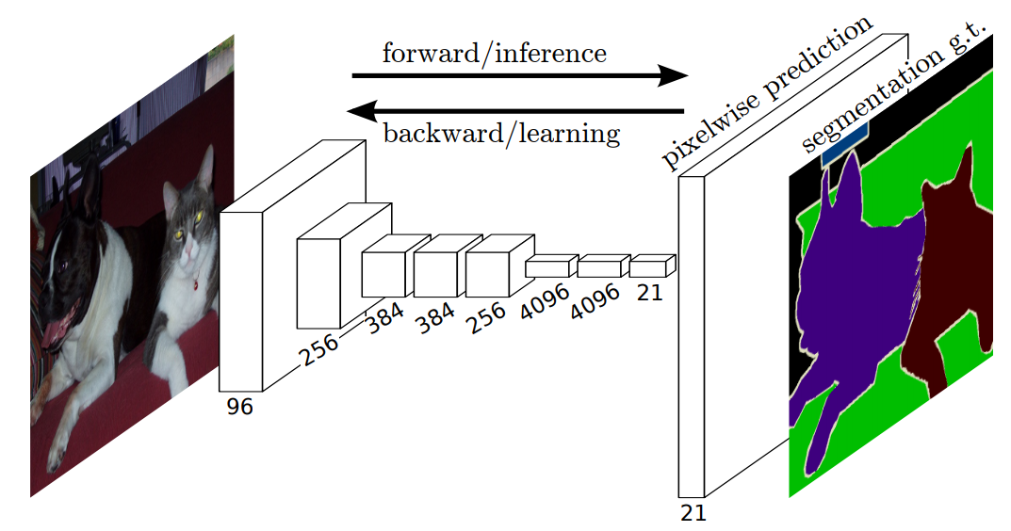
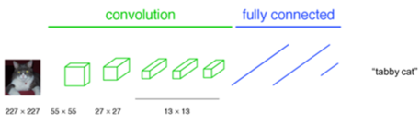
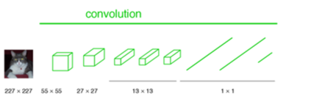
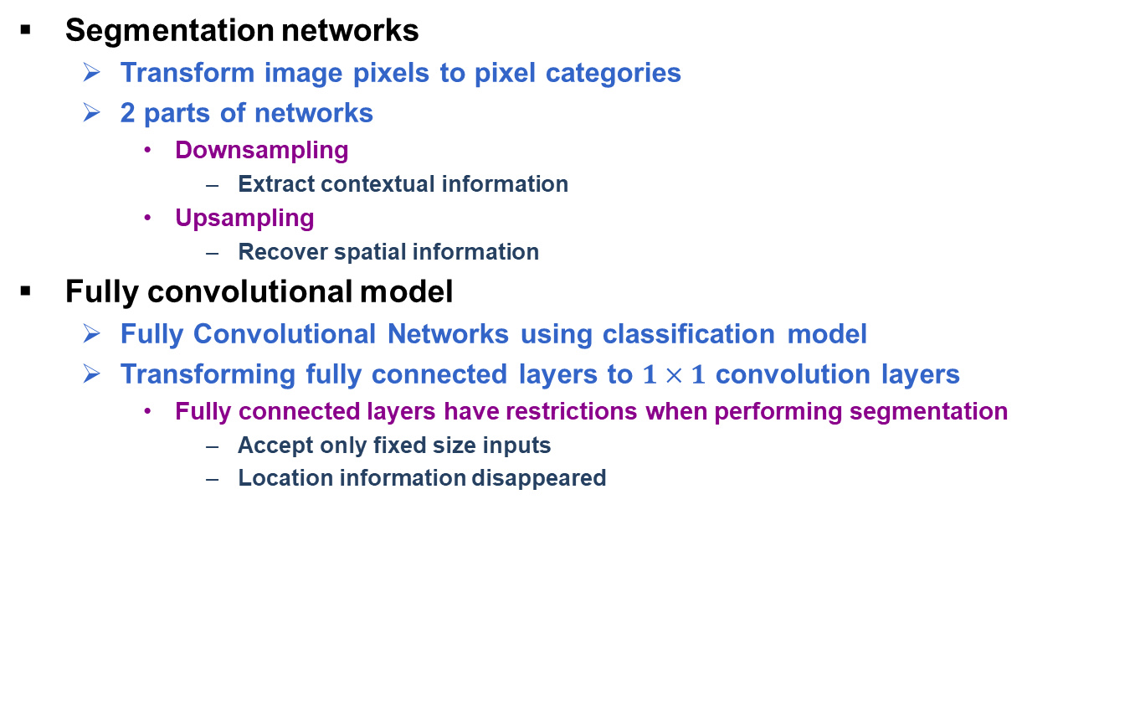
Fully Convolutional Networks (1/3)
Segmentation networks
Transform image pixels to pixel categories
2 parts of networks
Downsampling
Extract contextual information
Upsampling
Recover spatial information
Fully convolutional model
Fully Convolutional Networks using classification model
Transforming fully connected layers to $1×1$ convolution layers
Fully connected layers have restrictions when performing segmentation
Accept only fixed size inputs
Location information disappeared
Fully Convolution Networks
Example of classification model
Example of fully convolutional model
J. Long, E. Shelhamer and T. Darrell, "Fully Convolutional Networks for Semantic Segmentation," CVPR, 2015.

Slide 4
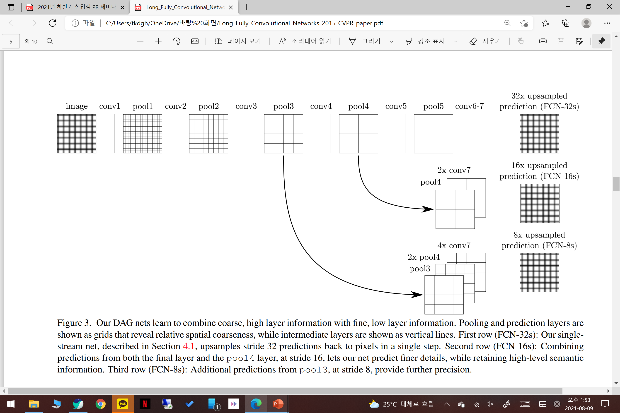
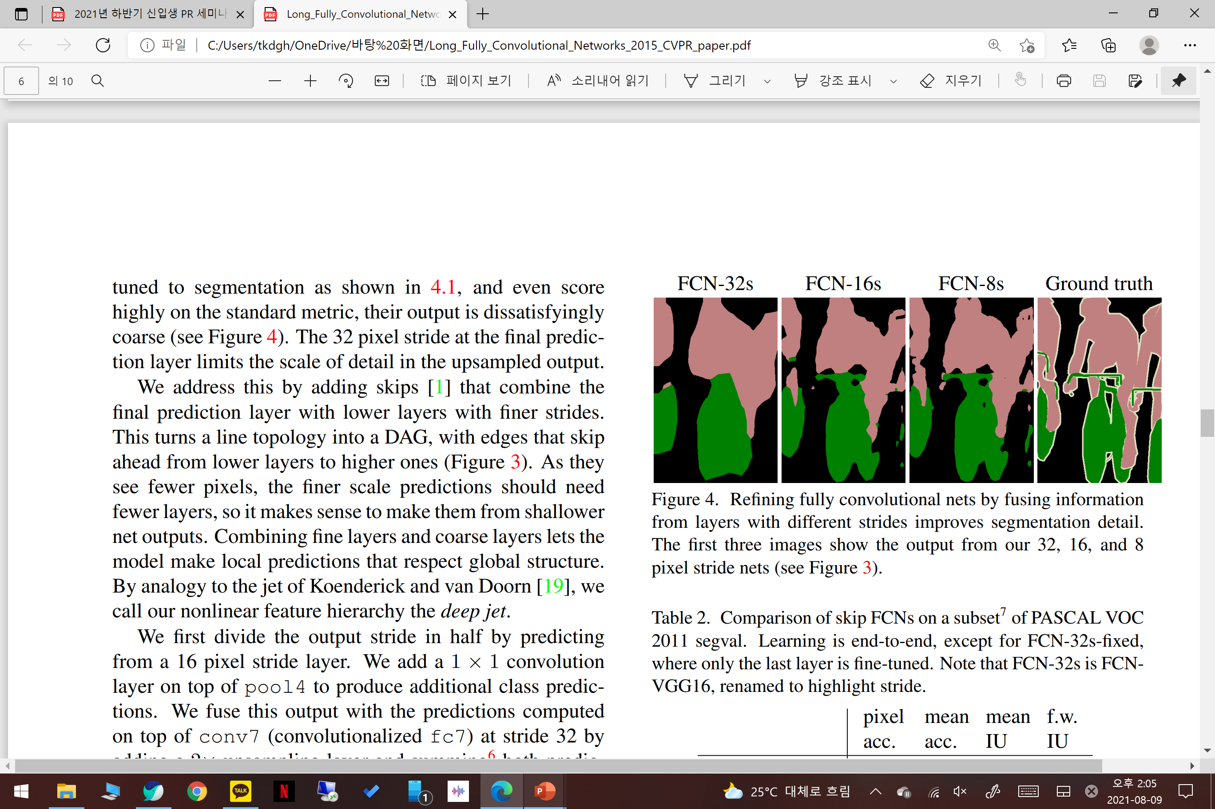
Fully Convolutional Networks (2/3)
Upsampling
Magnify feature maps to input size for pixel-by-pixel prediction
Using backward convolution
Determine the filter's parameters through learning
Bilinear filters can be learned
Non-linear upsampling enabled
Using skip architecture
Reinforce detail of feature map
Combine upsampling feature maps with downsampling feature maps
Upsampling feature maps have context information
Downsampling feature maps have spatial information
Results of FCN example with different strides
Skip architecture
J. Long, E. Shelhamer and T. Darrell, "Fully Convolutional Networks for Semantic Segmentation," CVPR, 2015.

Slide 5
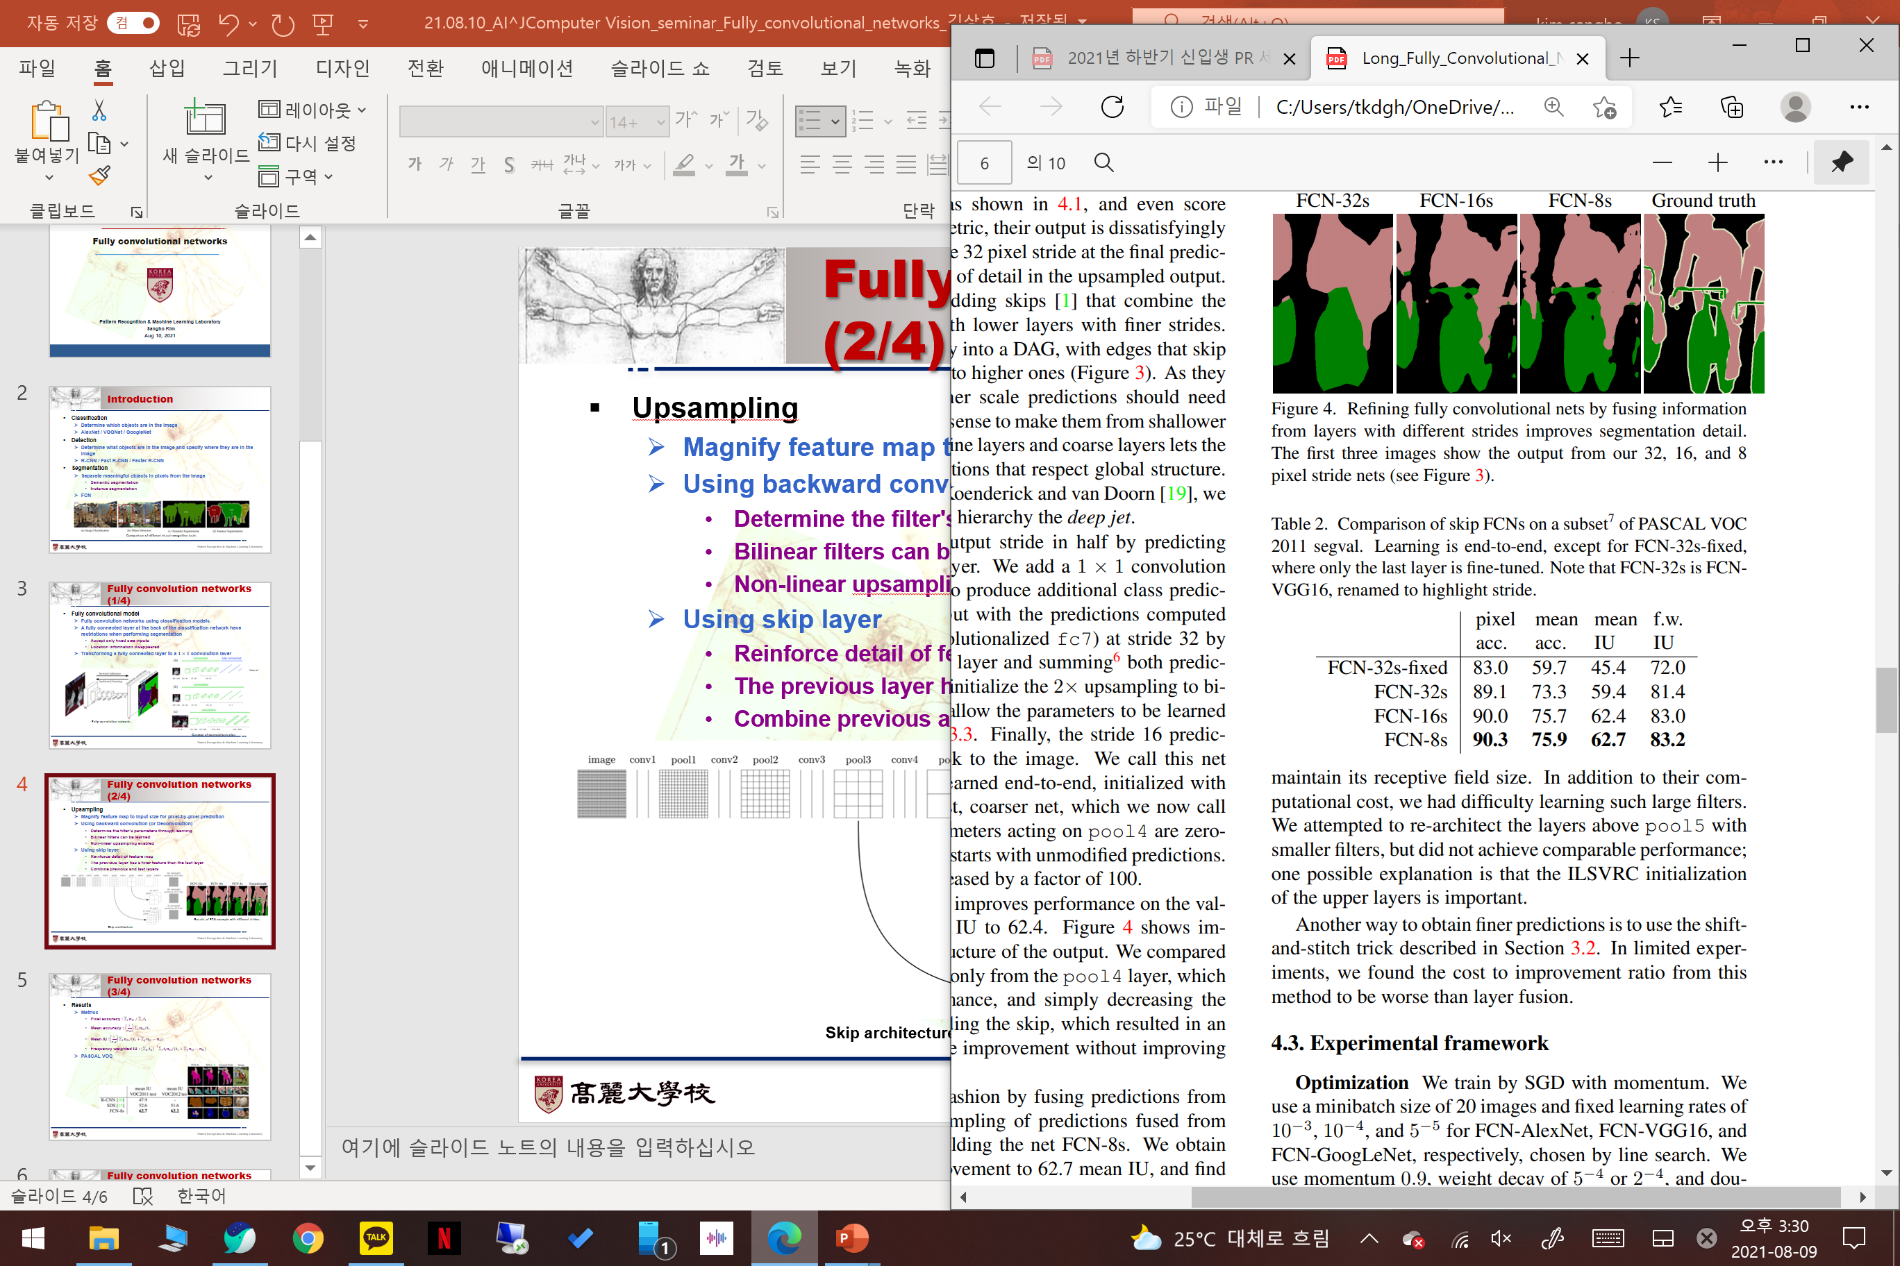
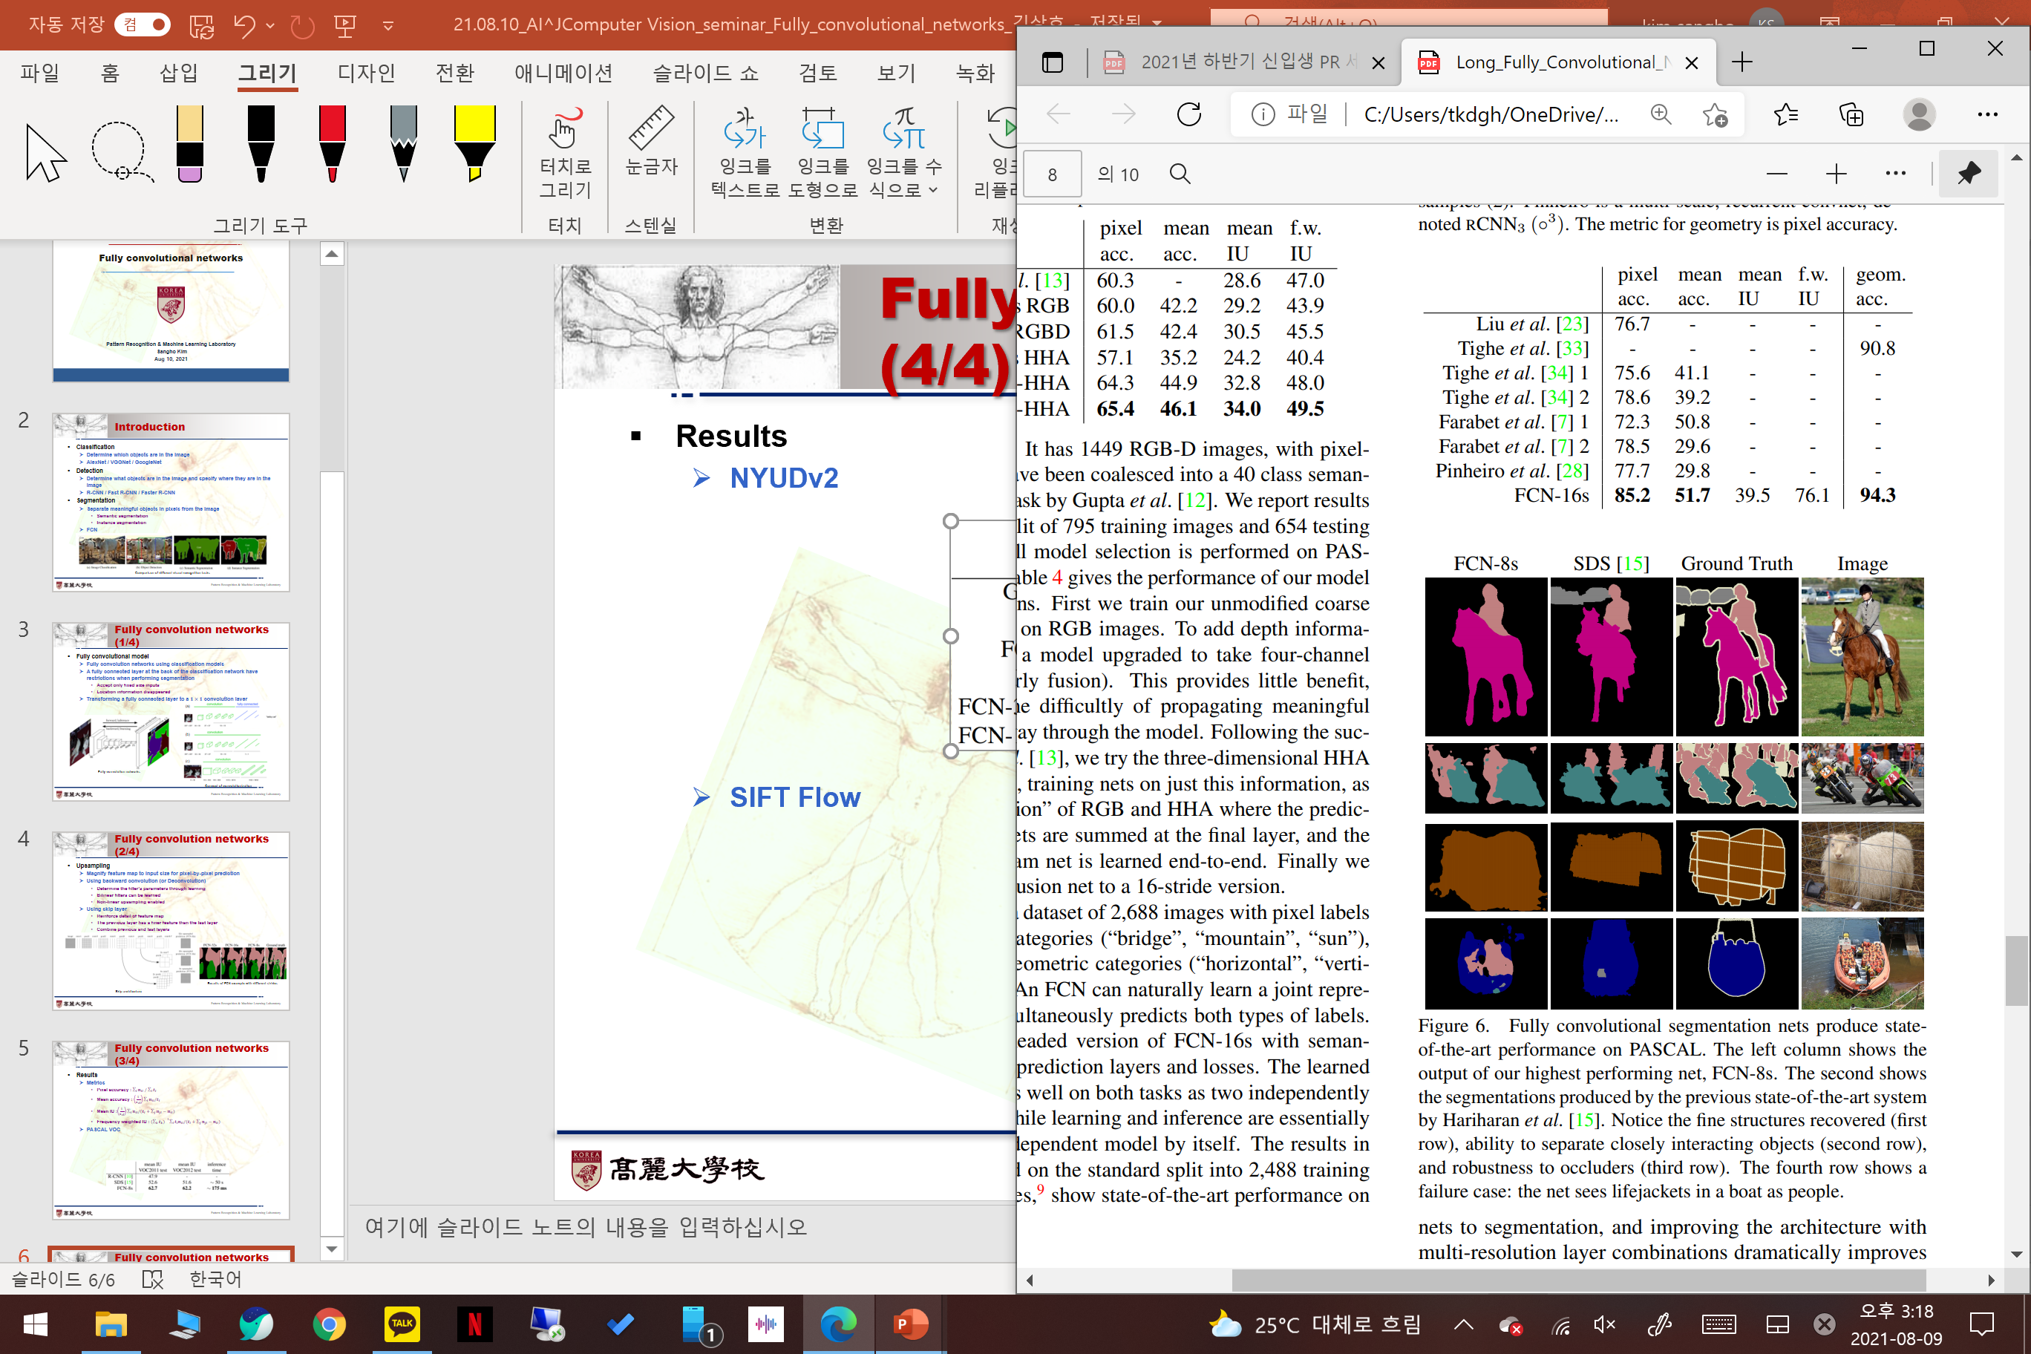
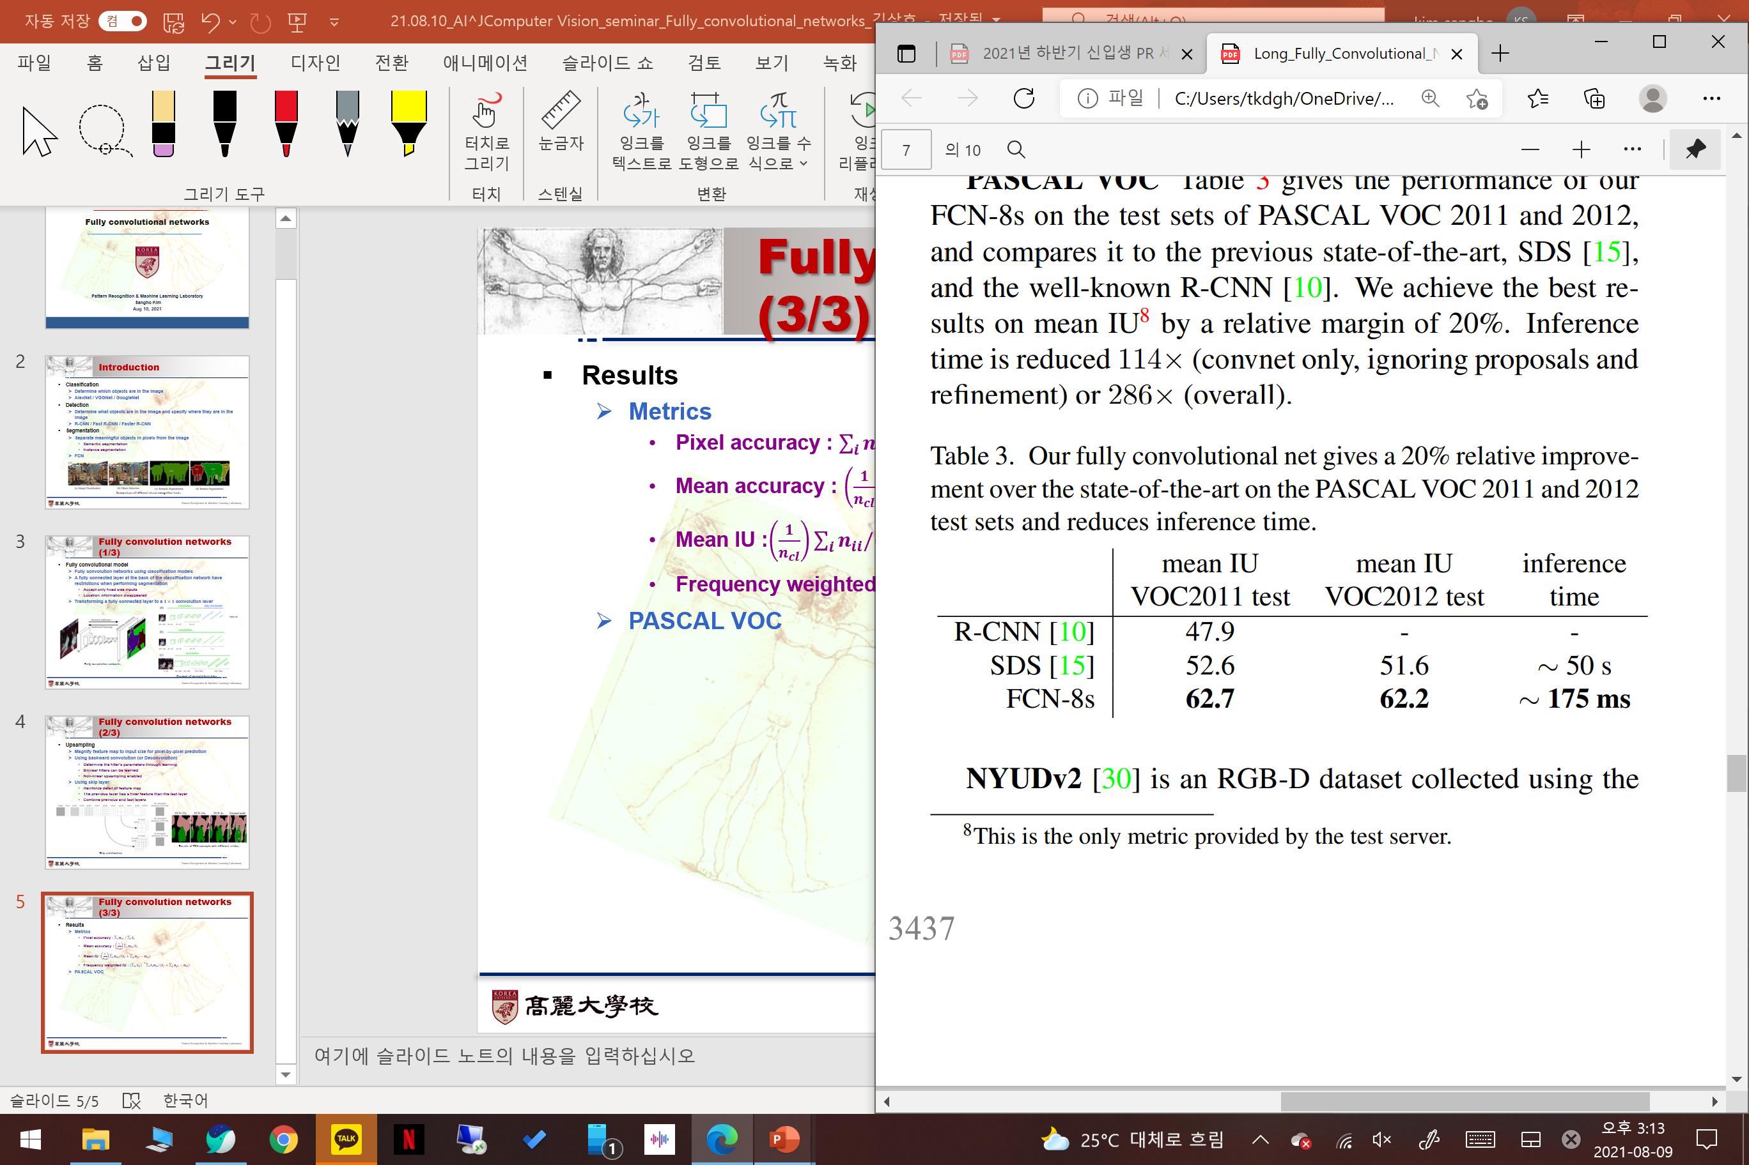
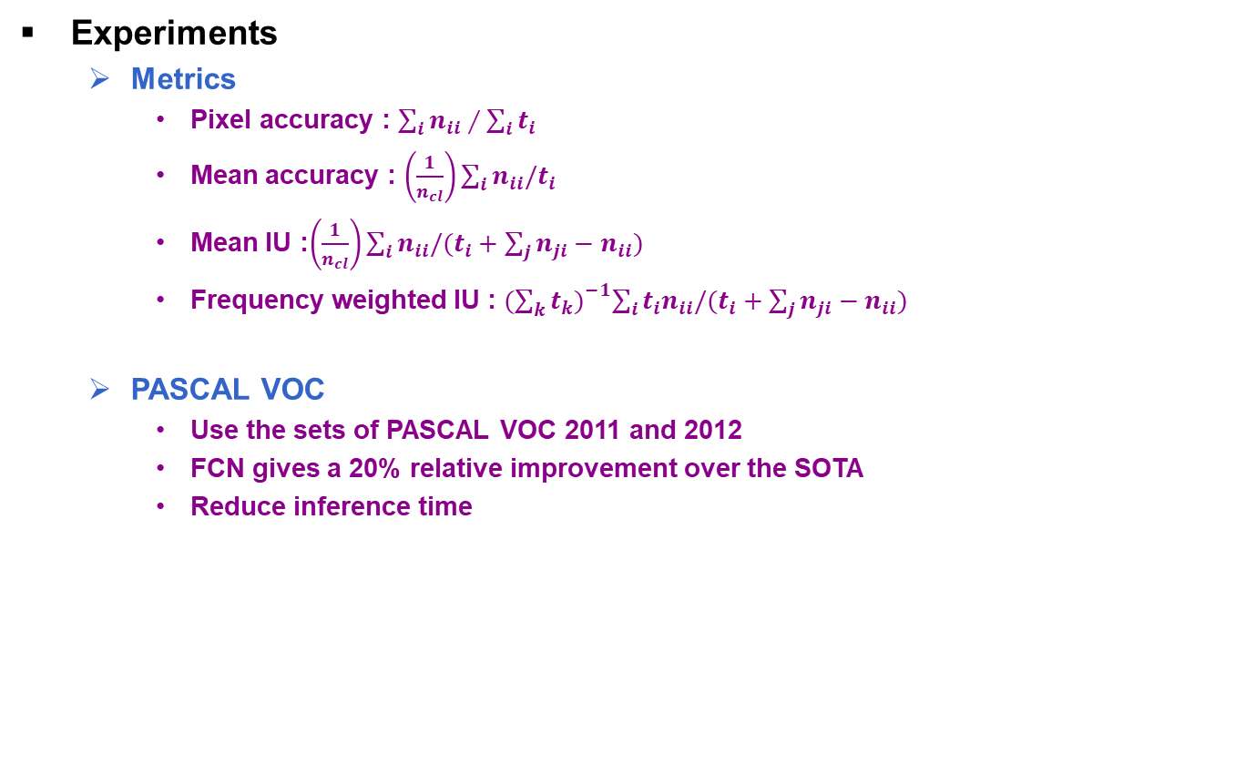
Fully Convolutional Networks (3/3)
Experiments
Metrics
Pixel accuracy : $\sum_{i}{n_{ii}∕\sum_{i}{t_{i}}}$
Mean accuracy : $\left(\frac{1}{n_{cl}}\right)\sum_{i}{n_{ii}/t_{i}}$
Mean IU :$\left(\frac{1}{n_{cl}}\right)\sum_{i}{n_{ii}/(t_{i}+\sum_{j}{n_{ji}−n_{ii})}}$
Frequency weighted IU : ${(\sum_{k}{t_{k})}}^{−1}\sum_{i}{{t_{i}n}_{ii}/(t_{i}+\sum_{j}{n_{ji}−n_{ii})}}$
PASCAL VOC
Use the sets of PASCAL VOC 2011 and 2012
FCN gives a 20% relative improvement over the SOTA
Reduce inference time
Comparison of skip FCNs on a subset of PASCAL VOC 2011
FCN-8 performance over previous SOTA
Results of FCN-8 compared to previous SOTA
J. Long, E. Shelhamer and T. Darrell, "Fully Convolutional Networks for Semantic Segmentation," CVPR, 2015.

